Slide 1
ORGANIC IRRITANT POISONS
PLANT TOXINS
Dr. SANJU. S
Asst.Professor
Dept.of Forensic Medicine & Toxicology

Slide 2
PHYTOTOXIN
A toxic protein , which resembles bacterial toxin in action & causes agglutination of red cells with some haemolysis.
Phytotoxin is a toxin produced by plant.
Animal toxalbumens are snake & scorpion venoms.

Slide 3
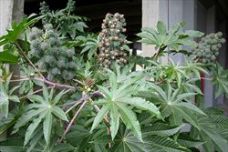
RICINUS COMMUNIS

Slide 4
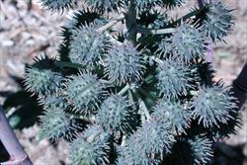
RICINUS FRUIT

Slide 5
RICINUS COMMUNIS
CASTOR PLANT (arandi) grows all over India
The plant contains toxalbumen ricin ,a water soluble glycoprotein ( highest level in seeds) & a powerful allergen(CBA).
The seeds are rich in a purgative oil , which is pale – yellow with a faint odour & acrid taste. PRESS CAKE
The unbroken seeds are non- poisonous when swallowed & cooked.

Slide 6
Ricinus fruit & seed.
FRUIT-1.2 to 2.5 cm. long.
3 lobed,ss,bg,rr when immature.
brown & bristly when ripe
Entire plant is poisonous.
SEED – variable ,smooth ,flattened ,oval ,mottled & dark brown or white with yellow brown or gray markings or wholly black or red. Size – big & small. small seeds are 1.2 cm long & 0.8 cm broad & resemble croton seeds. MOST POISONOUS
FRUIT
SEED

Slide 7
ACTION
Ricin blocks protein synthesis through the inhibition of RNA polymerase.
Ricin has a special binding protein that gain access to endoplasmic reticulum in GI mucosal cells causing severe diarrhoea.
6000 times powerful than cyanide.
absorbed through inhalation , ingestion , injection & through skin contact.

Slide 8
SIGNS AND SYMPTOMS
Dust of seeds produce allergy symptoms.
Other symptoms-
burning, salivation ,nausea, vomiting, bloody diarrhoea, thirst, impaired sight, weak rapid pulse , cramps in calves & abdominal muscles ,haemolysis, drowsiness ,delirium ,convulsions ,shallow breathing ,uraemia , jaundice ,dehydration , collapse & death.

Slide 9
FD,FP,TREATMENT & PM APP.
FD- 5 to 10 seeds ;ricin – 50 to 100 micro gram
FP -2 to 5 days.
Treatment – GL, AC, D, C,& S.
PM APP – mucosa congested , softened, & inflamed with occasional erosions & sub mucous haemorrhages. Seed in stomach & intestine.

Slide 10
Circumstances of poisoning
Accidental – children eats the seeds.
Rarely homicidal
Conjunctivitis – when powder of seeds are applied to eyes.

Slide 11
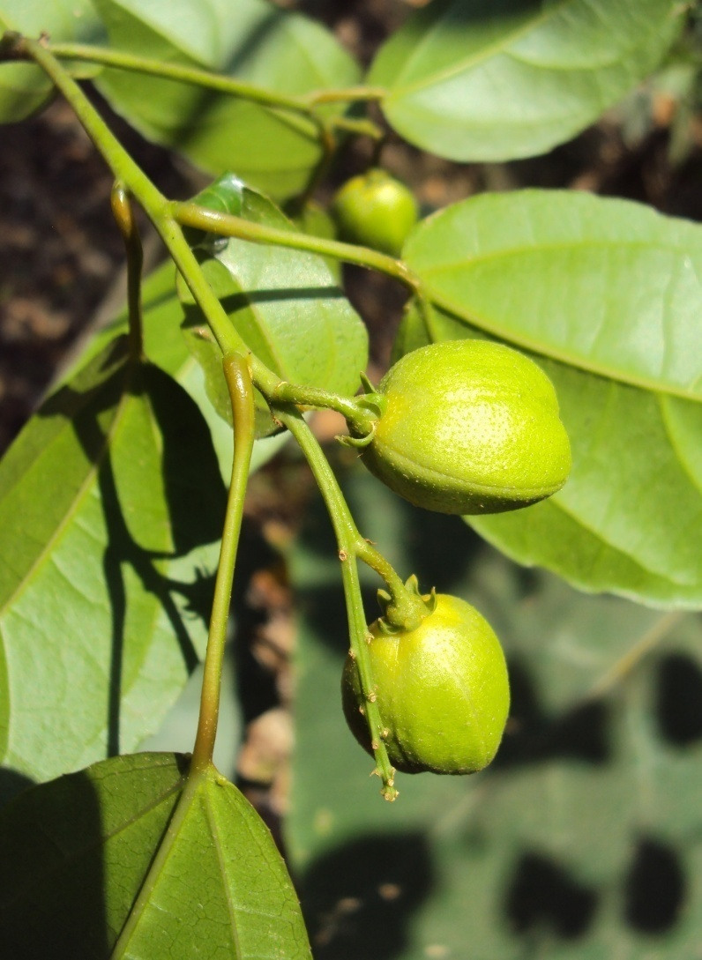
CROTON TIG

Slide 12
CROTON TIGLIUM
Toxalbumen – crotin in seeds.
Seeds – oval, dark brown with longitudinal lines . They have no smell.
Oil - brown , viscid has unpleasant odour & acrid ,burning taste ,but does not contain toxalbumen.
Oil contains a powerful vesicating resin composed of crotonoleic acid , methyl crotonic acid & several other fatty acids.

Slide 13
SIGNS AND SYMPTOMS
Hot burning pain from mouth to
stomach,salivation,vomiting,purging, collapse and death.
ON SKIN –
burning, redness & vesication.

Slide 14
FD,FP ,TREATMENT & PM APP.
FD – 4 to 5 seeds or 1 to 2 ml of oil.
FP - six hrs to three days .
TREATMENT – stomach wash,D,S
PM APPEARANCE - congestion , inflammation & erosion.

Slide 15
CIRCUMSTANCES OF POISONING.
ACCIDENTAL – swallowing croton oil by mistake or when taken in large doses as a purgative, or by eating seeds or inhaling dust.
Suicide & homicide - rare.
Root & oil - abortifacient.
Oil – arrow poison.

Slide 16
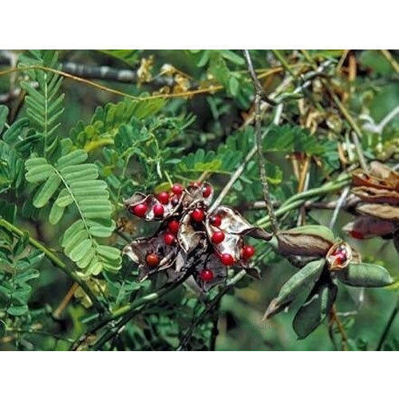
ABRUS PRECATORIUS

Slide 17
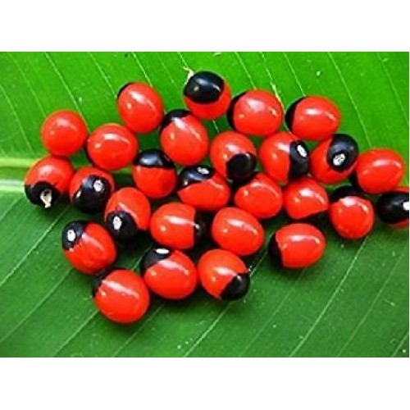
ABRUS SEEDS

Slide 18
ABRUS PRECATORIUS
Climber, woody at base. Leaves- feather like.
Flowers – pea –like. long ,purple,pink, yellowish or whitish.
Seed- egg shaped ,bright scarlet colour with a black spot at one end.odorless &tasteless.
Contains abrin , a toxalbumen which is similar to viperine snake venom; & abrine (N- methyl tryptophan) , an amino acid, haemoglutinin in the cotyledons; & abralin, a glucoside.

Slide 19
ACTION, FD & FP
ACTION – inhibits protein synthesis & causes cell death.
FD – 90 to 120 mg (1 - 2 seeds) by injection.
FP – 3 to 5 days.
subcutaneously abrin is 100 times as toxic as by oral route.

Slide 20
SIGNS & SYMPTOMS
By oral route , symptoms are delayed from few hrs to 2 – 3 days.
Irritation of upper GIT, hemorrhagic gastritis, bloody diarrhoea ,weakness , cold perspiration , trembling of hands ,weak rapid pulse ,miosis , rectal bleeding, Delayed cytotoxic effects occur in CNS ,liver , kidneys & adrenal glands 2 to 5 days after exposure.faintness,vertigo,vomiting,
dyspnoea,& general prostration occurs. Convulsions proceeds death.

Slide 21
‘SUIS’ – INJECTION
AS OF VIPERINE SNAKE BITE
When extract of seeds are injected under the skin of an animal, inflammation, oedema oozing of haemorrhagic fluid from the site of puncture & sometimes necrosis occur at the site of injection. Animal doesn't take food & drops down after 3 to 4 days & cannot move.Tetanic convulsions occur or becomes cold, drowsy, comatose & dies.

Slide 22
Injection in MAN
At the site of injection ,painful swelling & echymosis develops, with inflammation & necrosis.
Preparation of ‘ suis ‘-
seeds ,alone or mixed with datura , opium & onion are made into paste with spirit & water & small sharp pointed spikes or needles are made, which are then dried in sun. length – 15mm.weight – 90 to 120 mg.needles are inserted in to wooden handle

Slide 23
TREATMENT
Gastric lavage
Activated charcoal
Purgative
Injection of antiabrin
The needle should be dissected out.

Slide 24
POSTMORTEM FINDING
fragments of needles may be found
Oedema at the site of injection
Petechial haemorrhages under the skin, pleura, pericardium & skin.
Internal organs are congested & shows haemorrhages.

Slide 25
CIRCUMSTANCES OF POISONING.
Seeds are used for killing cattle, by leather workers to obtain hides.
For homicide ,the needle is kept between two fingers & the person is slapped which drives the needle into the body.
Powdered seeds are used by malingerers to produce conjunctivitis.
Prevents conception , abortifacient.
Arrow poison.

Slide 26
ERGOT
Dried sclerotinum of the fungus Claviceps purpurea, which grows on cereals like rye, barley ,wheat ,oats ,etc.It replaces the grain forming a curved, dark purple or black compact mass, 0.9 to 1 cm.long half cm thick , with lengthwise ridges and has peculiar odour & disagreeable taste.
Alkaloids - 30. in no.
3 are important.Ergotoxin ,ergotamine &
erogometrine (ecbolics).

Slide 27
ACTION , FD, FP & Rx
ACTION – stimulates adrenergic receptors , both peripherally & centrally. They directly stimulates muscle fibres.
FD - 2 to 10 g.
FP - 1 to several days.
TREATMENT – SW,AC , syrup of ipecac , c ,nitropruside for htn & ischemic changes, diazepam 0.1 mg .i.v. slowly for convulsions & vasodilators.

Slide 28
SIGNS & SYMPTOMS.
A/C – nausea, vomiting ,diarrhoea ,giddiness,
Tightness in the chest ,difficulty in breathing , marked muscular weakness & exhaustion.
There may be tingling of muscles in hands & feet.paraesthesia ,followed by twitching or cramps in muscles.
Bleeding from nose & other mucous surfaces. pulse is rapid & weak, pupils are dilated with dimness of vision, BP is ↑ed

Slide 29
ERGOTISM
CHRONIC POISONING – In CONVULSIVE TYPE -twitching ,tingling, numbness & pain in muscles.
Sensation of insects creeping under the skin.
Neurological disorder characterised by hallucinations, ataxia & convulsions .

Slide 30
ERGOTISM
In GANGRENOUS TYPE –there is burning pain(called St.Anthony’s fire) in limbs with inflammation & swelling.vesication ,gangrenous ulceration & sloughing .Dry gangrene of fingers ,toes , ears ,nose or hands & feet occurs.

Slide 31
PM APP & CIRCUMSTANCES.
PM APP –
Internal organs are congested.
There is degeneration of intima of smaller arterioles & thrombus formation.
POISONING - Consumption of bread made with contaminated rye .
Abortifacient.

Slide 32
CAPSICUM ANNUM
CHILLIES(red pepper;mirch) have a pungent odour & taste & are used as a condiment .
They are not fatal.
ACTIVE PRINCIPLE – CAPSSAICIN & CAPSICIN.
Irritant poison & causes difficulty in swallowing ,pain in stomach & inflammation.
Irritation on skin & on eyes it produces lachrymation , burning & redness.

Slide 33
Treatment & criminal uses.
Rx - bathe affected skin in vinegar or ice cold water.
- if ingested , sucking of ice cubes or sips of ice cold water.
CRIMINAL USES - powder is thrown into eyes to facilitate robbery.
- when theft or confession of some guilt has to be obtained ,the person is tortured by introducing the powder into vagina , rectum ,urethra or by rubbing on female breast.

Slide 34
SEMECARPUS ANACARDIUM
MARKING NUTS (bhilava) are black ,heart shaped with rough projection at the base.
They have a thick cellular pericarp ,which contains an irritant juice which is brownish, oily & acrid, but turns black on exposure to air.
ACTIVE PRINCIPLE - semecarpol & bhilawanol.

Slide 35
SIGNS & SYMPTOMS
EXTERNALLY – juice causes irritation & painful blister which contains acrid serum , which produces eczematous eruptions of neighbouring skin & there is itching.
The lesion resembles a BRUISE. later ulcer develops & there may be sloughing.
ORALLY – blisters on throat and severe GIT irritation ,dyspnoea,tachycardi ,hypotension ,cyanosis, absence of reflexes ,delirium , coma & death.

Slide 36
BRUISE - LIKE
POINTS | BRUISE | LESIONS DUE TO SEMICARPUS
SHAPE | Regular | Irregular
MARGIN | Diffused | Sharp & clear
SWELLING | present | Absent
COLOUR CHANGE | Occurs | Doesnot occur
ITCHING | absent | Present
BLISTERS | Absent | Present on margin
CAUSE | Rupture of capillaries | Chemical change
EXTRAVASATION IN TISSUES | Present | absent
NAIL BEDS | Nothing | Similar lesion

Slide 37
FD ,FP, TREATMENT & PM
FD – 5 to 10 g
FP - 12 to 24 hrs.
Rx - GL , D ,EXTERNALLY - wash with Luke warm water containing antiseptic.
PM –Blisters on mouth ,throat & stomach, which are congested & inflamed.

Slide 38
CIRCUMSTANCES OF POISONING.
Accidentally – Administration of juice by quacks.
Juice is introduced into vagina as a punishment for infidelity.
To support a false charge of assault , bruise – like is produced.
Juice may be thrown on the body to cause injury.
For criminal abortion bruised nut is applied to cervical os .
Ophthalmic by malingerers.

Slide 39
CALOTROPIS
CALOTROPIS GIGANTEA – PURPLE flower.
CALOTROPIS PROCERA - WHITE flower.
ACTIVE PRINCIPLE - Uscharin , calotoxin , calactin & calotropin(glycoside).TRYPSIN in milky juice(thick acrid juice yielded by incised leaves & stem).

Slide 40
SIGNS & SYMPTOMS
EXTERNALLY - Redness & VESICATION ,when applied to skin.
ORALLY - acrid bitter taste & burning in throat & stomach , salivation , stomatitis , vomiting , diarrhoea , dilated pupils ,tetanic convulsions , collapse & death

Slide 41
FD , FP , Rx & PM APP
FD - uncertain.
FP – 6 to 12 hrs.
Rx -SW , D & S.
PM APP - Dilated pupils , froth at nostrils ,stomatitis & inflammation of GIT.
Abdominal viscera & brain are congested.

Slide 42
CIRCUMSTANCES OF POISONING
Used in Indian medicine.
Juice is taken by mouth or introduced into uterus as an abortion stick
For infanticide
As vesicant
Cattle poison
As arrow poison
Root is poisonous to cobras

Slide 43
CANTHARIDES
SPANISH FLY (BLISTER BEETLE)
2cm long & 0.6cm broad.
Powder of dried body is greyish brown & contains shiny green particles.
ACTIVE PRINCIPLE – cantharidin.
locally irritant & NEPHROTOXIC.
Indian fly is 2.5 cm long & 0.8 cm broad.
Contains 2.9% cantharidin
Cantharidin is readily absorbed from all surfaces.

Slide 44
SYMPTOMS
On skin –redness & burning are produced after 2 to 3 hrs followed by vesication.
Internally , within half to two hrs , burning sensation in mouth & throat, followed by pain in stomach , nv of bloody mucus , severe thirst, dysphagia & difficulty in speech. Dull pain in loins .urine is scanty & blood stained . priapism & tenesmus.abortion ; prostration , convulsions coma & death

Slide 45
FD , FP ,Rx & PM APP
FD – 15 to 50 mg of cantharidin or one & half to 3 g of powdered cantharides.
FP- 24 to 56 hrs.
Rx - SW , D & S .
PM - inflammation , vesication , swelling , ulceration , congestion , petechial haemorrhages , erosion from mouth to upper small intestine. Particles of insect sticks to mucosa . Urinary organs – inflamed & hemorrhagic. Hemorrhagic heart & lungs.

Slide 46
CIRCUMSTANCES OF POISONING
Accidental poisoning by its external application as counter irritant.
Aphrodisiac.
Criminal abortion.

